Slide 1
Today in LSS – Research Wrap-up & Open Memo Instruction Review
Boolean Searching
How Do We Get Started?
Open Memo Instruction Review

Slide 2
Boolean Searching

Slide 3

Don’t be scared by Boolean
Boolean is a logic-based search method in legal databases like Westlaw and Lexis
Rather than using ordinary, plain language to run a search, Boolean relies on the combination of keywords with specific logical connectors to control how a database finds, includes, or excludes documents
Unlike natural language searches or AI, Boolean lets the searcher be precise with language. This can help you find a needle in haystack.

Slide 4
Steps to Effective Boolean Searching
Use Boolean as a last step, only after you have a firm handle on your issue, and you have already tried secondary sources, AI, statutory notes of decision, and the “one good case” method (backward, forward, sideways).
Use Boolean along with filters to cut down possible results.
Capture relevant results by brainstorming synonyms and like terms
Try an iterative “search within results” process to be able to move more quickly through results.

Slide 5
Boolean Tips
Click on the “Advanced” button in Westlaw or Lexis to see a list of terms and connectors, or to help you construct a Boolean search
If you type “adv:” into the search bar before your search, it will perform a Boolean search for you. (Sometimes, it understands that’s what you want, and it puts it there automatically).

Slide 6
In Boolean logic, if you type:
adv: free speech
you are asking the robot to find you documents with the word “free” or the word “speech.”
If you type:
adv: free & speech
You are asking the robot to find all documents with the word “free” AND the word “speech.”
If you type:
“free speech”
The robot will search documents for that exact phrase.

Slide 7
Take a look at the terms & connectors list. Construct the following Boolean searches:
Cases in which the words “prisoner” and “agent” appear in the same sentence.
  Adv: prisoner /s agent
Cases in which the word “prisoner” is before the word “agent” in the same sentence.
Adv: prisoner +s agent
Cases in which “prisoner” and “agent” appear in the same paragraph in any order.
Adv: prisoner /p agent
Cases in which “agent” precedes the word “prisoner” in the same paragraph.
Adv: agent +p prisoner

Slide 8
What if I wanted to search for cases with the words “free” or “freedom” in the same sentence as “speech”?
adv: free! /s speech (actually this will get you free, frees, freed, and freedom)
adv: (free freedom) /s speech

Slide 9
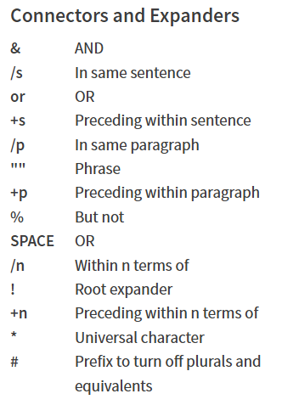
Notes:
Click on “Advanced” search button to see a list of connectors and expanders.

Slide 10
Open Memo Review
When is it due?
  Nov. 8 at 5 pm on Canvas
What are the issues I need to cover?
  Diversity Jurisdiction & Malicious Prosecution
What issue do I need to research?
  Malicious Prosecution
Do I need to focus on all elements of the malicious prosecution equally?
  No, main focus is on elements 2 & 3. Want of Probable Cause & Malice
What do I do with Elements 1 & 4?
  Quickly address by Rule – Based Reasoning

Slide 11
Rule-Based Reasoning
Apply a rule to a set of facts (general to specific)
Show how facts fit or don’t fit the rule
Example: Carlos Catastrophe
Under Florida law, to be considered an EPAMD, a vehicle must have two non-tandem wheels, an electric propulsion system, . . .
Here, Carlos’s motorized cooler has three wheels, two of which are side by side, and a hybrid propulsion system, . . .
Therefore, _____________.
Notes:
RBR is a form of deductive reasoning (from the general to the specific).

Slide 12
Pre-Analysis: Determine the Jurisdiction
Federal or State?
State
Which state?
Which court in that state?
What authorities are binding on your court?
Federal
Which circuit?
Which court in that circuit?
What authorities are binding on your court?

Slide 13
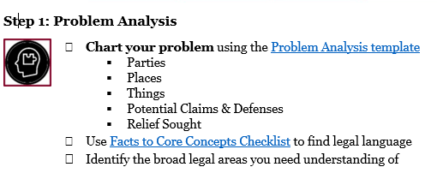

Slide 14
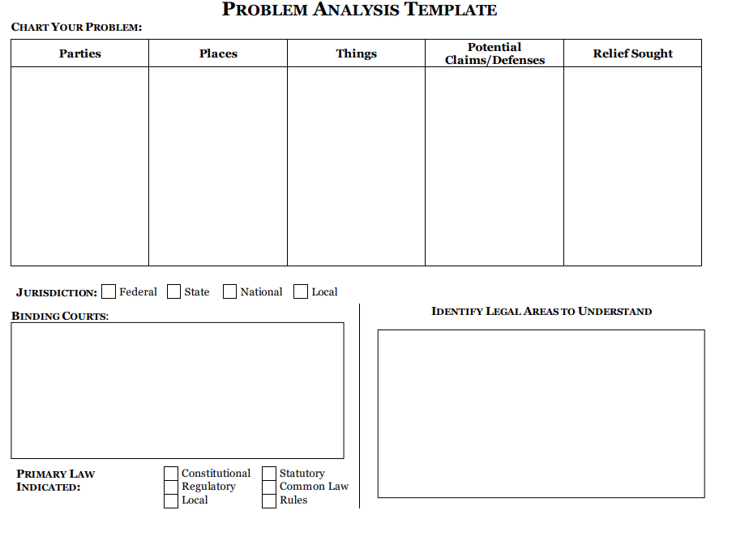

Slide 15
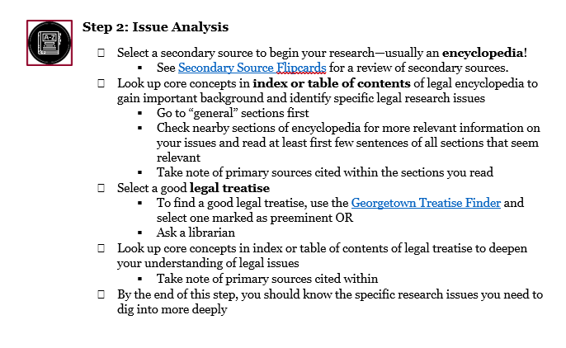

Slide 16
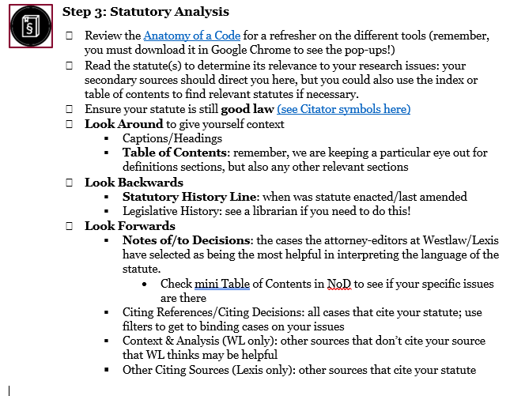

Slide 17

Homework
Analyze the issue through the Problem Analysis Template Chart or something similar that can allow you to organize the facts presented
Start Researching – Focus on Finding a Good Secondary Source

